Slide 1
Full Stack Web Development
Redis / Getting Started

Slide 2
What Is Redis?
Redis is an open source (BSD licensed) in-memory data structure store used as a database, cache and message broker
Redis can be classified as a “Key / Value Store”
It uses built in replication, LUA scripting and different levels of data-persistence

Slide 3
Redis vs. Other NoSQL
Redis does work in a similar way as some NoSQL technologies like MongoDB and CouchDB when it comes to the way it stores data
What is very different is that Redis is memory-based which those systems are disk-based
Redis is also used for caching

Slide 4
Types Of Data In Redis
Redis supports the following data types…
Strings
Hashes
Lists
Sets
Sorted Sets
Bitmaps
Hyperlogs
Geospatial Indexes

Slide 5
Transactions
Transactions allow the execution of a group of commands in a single step with 2 important guarantees..
All the commands are serialized and executed sequentially
Either ALL or NONE of the commands are executed
A transaction is entered using the MULTI command. At that point the user can issue commands and they will not be executed but put into a queue until EXEC is called

Slide 6
Publish / Subscribe
Redis uses a publish/subscription messaging paradigm where senders (publishers) are not programmed to send messages to receivers (subscribers), rather published messages are characterized into channels without knowledge of what subscribers there will be
A “message” is an array reply with 3 elements – Subscribe / Unsubscribe / Message

Slide 7
Partitioning
The process of splitting your data up into multiple Redis instances, so that every instance will contain a subset of your keys
Allows for much larger databases, uses the sum of the memory of multiple machines
Allows scaling the computational power to multiple cores and multiple computers

Slide 8
Redis-CLI
The Redis command line interface is a simple program that allows us to send commands to Redis and read replies sent by the server
Multiple Modes:
Interactive: Basic line editing capabilities
Slave Simulation
Replication Stream

Slide 9
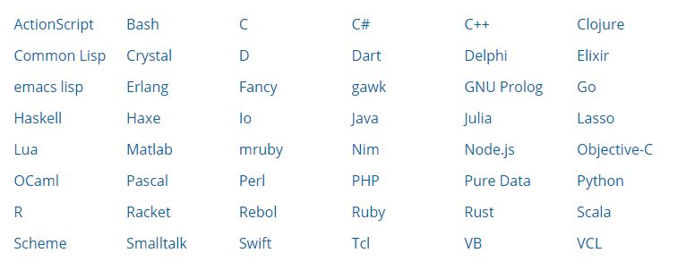
Redis Clients
Redis can be implemented in the following programming languages…

Slide 10


